Slide 1
Predicting Diseases (Part 2 of 2)
Josh Gardner
DSC 680 Applied Data Science

Slide 2

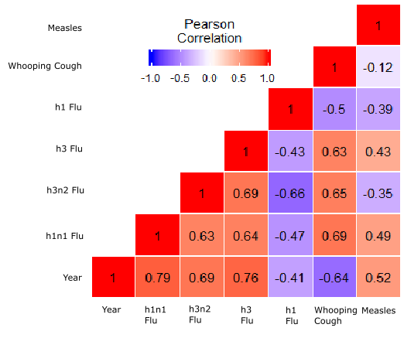

What Are the Correlations?
Source
Statistical tools for high-throughput data analysis. “ggplot2: Quick correlation matrix heatmap – R software and data visualization. Retrieved 19 Sep. 2019 from http://www.sthda.com/english/wiki/ggplot2-quick-correlation-matrix-heatmap-r-software-and-data-visualization

Slide 3
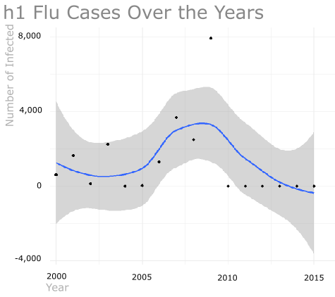
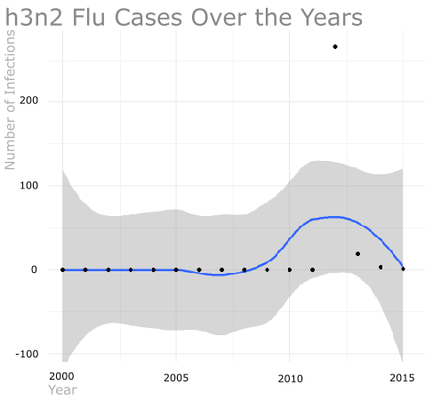
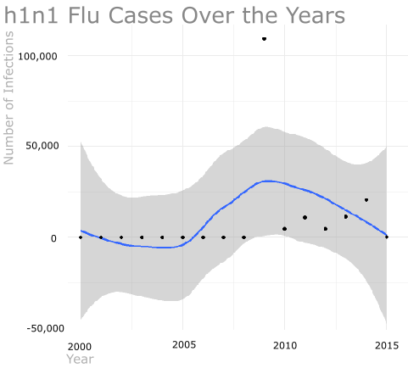
Regression
The h1, h1n1, and h3n2 strains of Flu are trending down in recent years.

Slide 4
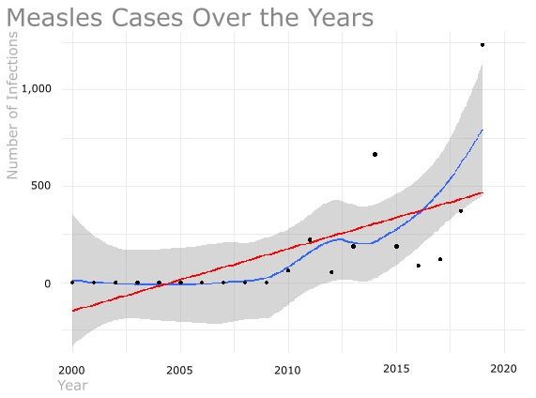
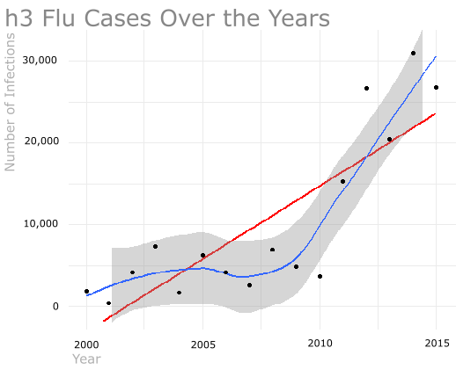
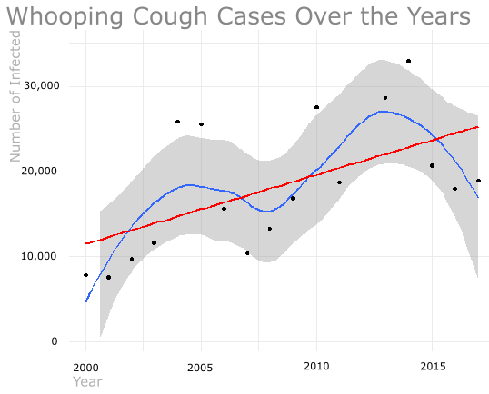
Regression
The h3 strain of Flu, Measles, and Whooping Cough are all trending up over recent years.

Slide 5
Predictions
Whooping Cough, h1n1 Flu, and h3 Flu are the most likely to have the highest number of new infections over the next few years.
The h3 Flu is the most likely of the three to have the highest count of new infections with the Whooping Cough in a close second.

Slide 6
Revisiting Research Questions
Which diseases are strongly correlated to each other?
Whooping Cough and h3n2 Flu have a strong, positive correlation. This means that as one increases, the other increases.
Measles and h1n1 Flu also have a strong, positive correlations.
Measles and h3 Flu also have a strong, positive correlation.
h1 Flu and h3 Flu have a strong, negative correlation. This means that as one increases, the other decreases.

Slide 7
Revisiting Research Questions
2. Do preventable diseases have outbreaks during the same time?
Some of the highly correlated diseases do fluctuate together, but very few have high numbers of infections at the same time.
The different diseases have outbreaks during different years.

Slide 8
Revisiting Research Questions
3. Looking at past trends in the numbers of infected individuals, what are the projected number of infected individuals over the next few years?
Five of the six diseases are projected to increase in the number of infections over the next few years.
Only the h1 Flu is projected to decrease in the number of infections over the next few years.

Slide 9
Revisiting Research Questions
4. Looking at each disease’s projected infections, which disease is likely to have the next outbreak?
Five of the diseases are projected to continue increasing in the number of infected over the next few years. Of these five, the Whooping Cough, h1n1 Flu, and h3 Flu are projected to have the highest number of infections.
Of these three, the h3 Flu is projected to have the highest number of infections over the next few years.

Slide 10
Summary
Over the past few years, more and more news stories are focusing on which disease is currently in the midst of an outbreak. Looking at the national infection numbers for six different diseases, it is possible to predict which diseases will have a higher number of new infections over the next few years and which of the diseases are correlated to each other.
Each disease that was analyzed has a different threshold for what an outbreak looks like. Because of this, each disease has had an outbreak over the past few years and has a chance of having another outbreak within the next few years.
Of the analyzed diseases, the Whooping Cough, h1n1 Flu, and h3 Flu are all projected to have high numbers of infections over the next few years. Of these diseases, the h3 Flu is the most likely to have the highest number of new infections.

Slide 11
Sources
Galvin, G. (26 Aug. 2019) US News. “Measles cases tick up as officials warn of possible Disneyland exposure.” Retrieved 14 Sep. 2019 from https://www.usnews.com/news/healthiest-communities/articles/2019-08-26/measles-cases-rise-to-1215-amid-disneyland-warning
Fox News. (29 Dec. 2018) “Officials warn about increased flu activity across the country.” Retrieved 14 Sep. 2019 from https://video.foxnews.com/v/5984425255001/#sp=show-clips
Centers for Disease Control and Prevention. “CDC global health in the news.” Retrieved 14 Sep. 2019 from https://www.cdc.gov/globalhealth/inthenews.htm
Baylor College of Medicine. “Introduction to infectious diseases.” Retrieved 14 Sep. 2019 from https://www.bcm.edu/departments/molecular-virology-and-microbiology/emerging-infections-and-biodefense/introduction-to-infectious-diseases
Center for Disease Control and Prevention. “Flu view: National, regional, and state level outpatient illness and viral surveillance.” Retrieved 31 Aug. 2019 from https://gis.cdc.gov/grasp/fluview/fluportaldashboard.html
Center for Disease Control and Prevention. “Flu view: Age group distribution of influenza positive specimens reported by public health laboratories, national summary, 2018-19 influenza season through the week ending August 24, 2019.” Retrieved 31 Aug. 2019 from https://gis.cdc.gov/grasp/fluview/flu_by_age_virus.html
Center for Disease Control and Prevention. “Overview of influenza surveillance in the United States.” Retrieved 31 Aug. 2019 from https://www.cdc.gov/flu/weekly/overview.html
Center for Disease Control and Prevention. “Measles cases in 2019.” Retrieved on 31 Aug. 2019 from https://www.cdc.gov/measles/cases-outbreaks.html
Rockland County. “Measles information.” Retrieved 31 Aug. 2019 from http://rocklandgov.com/departments/health/measles-information/
NYC Health. “Measles.” Retrieved 31 Aug. 2019 from https://www1.nyc.gov/site/doh/health/health-topics/measles.page
Washington State Department of Health. “Measles 2019.” Retrieved 31 Aug. 2019 from https://www.doh.wa.gov/YouandYourFamily/IllnessandDisease/Measles/Measles2019
California Department of Public Health. “Measles.” Retrieved 31 Aug. 2019 from https://www.cdph.ca.gov/Programs/CID/DCDC/Pages/Immunization/measles.aspx
City of El Paso. “Measles Information.” Retrieved 31 Aug. 2019 from http://www.elpasotexas.gov/health/public%20health/current-events/measles-information
New York State Department of Health. “Joint statement from New York State Department of Health and Wyoming County Department of Health: measles investigation.” Retrieved 31 Aug. 2019 from https://www.health.ny.gov/press/releases/2019/2019-08-08_doh_wyoming_county_measles_joint_release.htm
Centers for Disease Control and Prevention. “Pertussis (Whooping Cough) Surveillance & Reporting.” Retrieved 31 Aug. 2019 from https://www.cdc.gov/pertussis/surv-reporting.html
Centers for Disease Control and Prevention. “Pertussis (Whooping Cough) Pertussis incidence by age group and year (1990-2017).” Retrieved 31 Aug. 2019 from https://www.cdc.gov/pertussis/surv-reporting/cases-by-age-group-and-year.html
Centers for Disease Control and Prevention. “Pertussis (whooping cough) Pertussis cases by year.” Retrieved 31 Aug. 2019 from https://www.cdc.gov/pertussis/surv-reporting/cases-by-year.html
Summary Tables
Centers for Disease Control and Prevention. “National Notifiable Infectious Diseases and Conditions: United States (2017).” Retrieved 5 Sep. 2019 from https://wonder.cdc.gov/nndss/static/2017/annual/2017-table4.html
Centers for Disease Control and Prevention. “National Notifiable Infectious Diseases and Conditions: United States (2016).” Retrieved 5 Sep. 2019 from https://wonder.cdc.gov/nndss/static/2016/annual/2016-table4.html
Statistical tools for high-throughput data analysis. “ggplot2: Quick correlation matrix heatmap – R software and data visualization. Retrieved 19 Sep. 2019 from http://www.sthda.com/english/wiki/ggplot2-quick-correlation-matrix-heatmap-r-software-and-data-visualization
Immunization Action Coalition. “Pertussis (Whooping Cough) questions and answers.” Retrieved 19 Sep. 2019 from https://www.immunize.org/catg.d/p4212.pdf
Centers for Disease Control and Prevention. “Influenza (Flu) Upcoming 2019-2020 Flu Season.” Retrieved 19 Sep. 20190 from https://www.cdc.gov/flu/season/flu-season-2019-2020.htm
Centers for Disease Control and Protection. “H1N1 Flu.” Retrieved 19 Sep. 2019 from https://www.cdc.gov/h1n1flu/vaccination/general.htm
Centers for Disease Control and Prevention. “Influenza (Flu) Types of Influenza Viruses.” Retrieved 19 Sep. 2019 from https://www.cdc.gov/flu/about/viruses/types.htm
May, A. (25 Feb. 2019) USA Today. “Flu outbreak with second strain could last until May. What you need to know.” Retrieved 19 Sep. 2019 from https://www.usatoday.com/story/news/health/2019/02/25/flu-season-2019-severe-strain-rise-what-you-should-know/2978595002/

